Slide 1

Mood Spotifier with Chatbot (MODIC)
Team Id: 22_AI_2A_10
Hari Om Shukla (2101641520067)
Sarthak Jain (2101641520123)
Pratham Singh (2101641520108)
Alokik Prakash Gupta (2101641520012)
Rishabh Singh Gaur (2101641520118)

Slide 2
Table of Contents
Project Objective
Feasibility Study (technical feasibility, operational feasibility, economic feasibility, schedule feasibility and legal feasibility.)
Methodology(Architecture/ DFD/ER Diagram)
Tools/Technology Uses
Role of team members in the project and their expertise areas.
References

Slide 3
Project Objective
We have developed the web-application in following steps:-
It starts with a conversation between user and program.
Program will take a real-time image of the user.
Image will be processed and mood of the user will be detected.
The detected mood will be cross-checked from the user end.
If OK, then music album of related mood will be shown.
One of the song will be played.

Slide 4
Feasibility Study
Technical feasibility:-
The technologies used in the development of this project are AI and CV.
These technologies are very popular and a high level of research is going on in these fields of technology.
Hence, our project has a high level of technical feasibility.
Legal Feasibility:-
All the content used in the project is taken from open sources. There is no violation of any government laws of Intellectual Property.

Slide 5
Feasibility Study
Operational Feasibility:-
Our developed program can run on browser nad hence easy to access and use.
Feedback system in this program enables it to operate in various conditions like extremely high or low lighting, their camera not working properly, they have a lower resolution camera which is unable to take a clear picture of their face. The user can give reply to the system as a feedback. Hence, operational feasibility of developed project is up to the mark.

Slide 6
Feasibility Study
Economic Feasibility:-
Our developed program is a open source program. Hence, this project doesn’t take any cost for contents and development.
Since, our project has almost no investment except time, this project can be developed by any person having knowledge of technologies and emerging fields. Hence, our project has a high degree of economic feasibility.

Slide 7
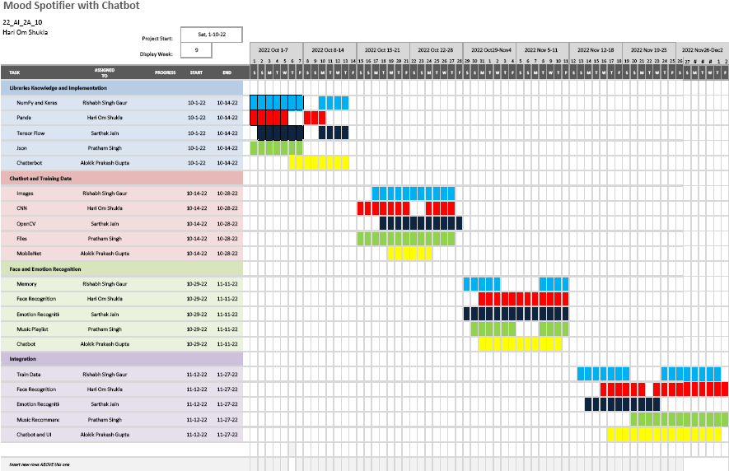
Feasibility Study Schedule feasibility:-

Slide 8
Methodology
I. Chatbot Module:
This system starts with a conversation to the user like “Hello”, ”What’s Your Mood”, “Let me check it”, etc. It is also used for getting feedback from the user. Chatbot will be implemented in python language using Chatterbot Library.
Each time a user enters a statement, the library saves the text that they entered and the text that the statement was in response to.
The program selects the closest matching response by searching for the closest matching known statement that matches the input, then chooses a response from the selection of known responses to that statement.

Slide 9
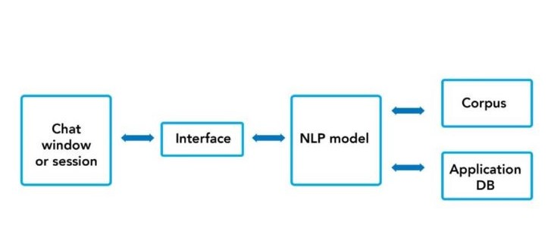
Fig.1 Architecture Diagram of Chatbot

Slide 10
Methodology
II. Mood Detection Module :
This Module is divided into two parts:
Face Detection — Ability to detect the location of face in any input image or frame. The output is the bounding box coordinates of the detected faces. For this task, the python library OpenCV was considered.
Mood Detection — Classification of the emotion on the face as happy, angry, sad, neutral, surprise, fear or disgust. Keras which is a CNN architecture model for Image Classification and Mobile Vision was used since it uses very less computation power.

Slide 11
Methodology
The dataset used for training was obtained by combining FER 2013 dataset [6] and MMA Facial Expression Recognition dataset [7] from Kaggle. Keras was used to train and test our model for seven classes - happy, angry, neutral, sad, surprise, fear and disgust. We trained it for different epochs and achieved an accuracy of approximately 75%.
The MMA Facial Expression Recognition dataset had images of different specifications. Thus, all these images were converted as per the images in FER 2013 dataset and combined to obtain an even larger dataset.

Slide 12
Methodology
III. Music Recommendation Module
The dataset of songs classified as per mood was found on Kaggle for two different languages - Hindi and English.
Research for a good cloud storage platform to store, retrieve and query this song data as per user’s request was conducted .
We have selected Kaggle for this purpose.

Slide 13
Methodology
IV. Integration
For the integration of these two modules, the trained Keras model was saved as an .h5 file, and this .h5 file was then converted to a .tflite file using TensorFlow Lite Converter.
It takes a TensorFlow model as input and generates a TensorFlow Lite model as output with .tflite extension. Since the Keras model is used, the size of the tflite file is expected be around 20- 25 Megabyte (MB) which was the desired size.
The labels.txt file contains the class labels of the model. All the appropriate methods were created for loading the model, running the interpreter and obtaining the results.

Slide 14
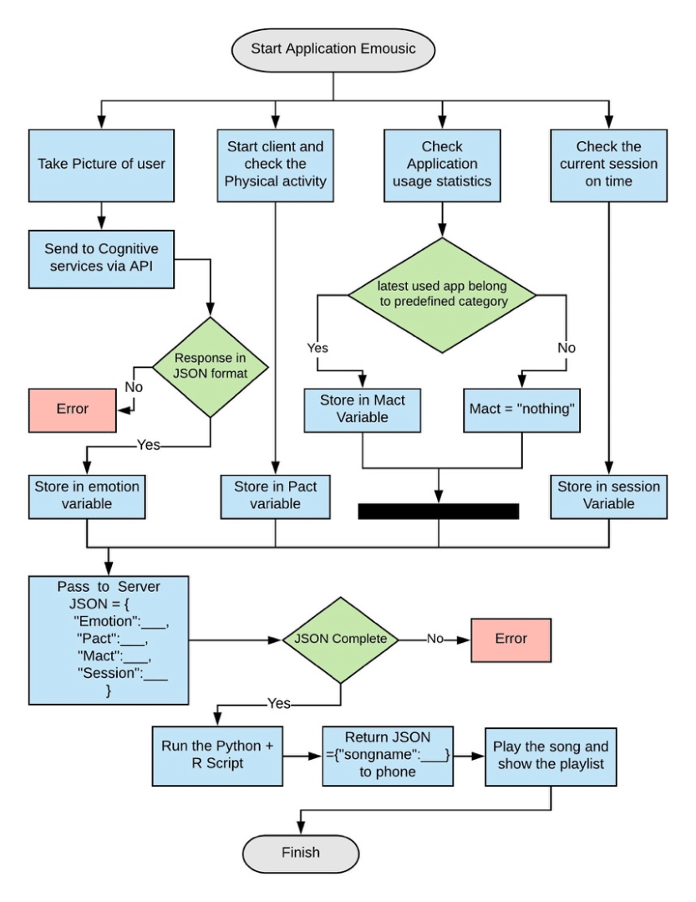
Fig.2 ER Diagram of Project

Slide 15
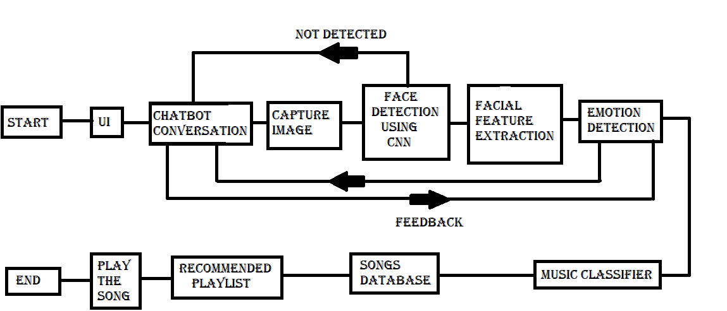
Fig.2 DFD of Project

Slide 16
Tools/Technology Used
1. Hardware Tools: 2. Software Tools:
Processor : Intel core i-5 Operating System – Microsoft Windows 10
Storage – 512 SSD Platform – Jupyter Notebook and V S Code
RAM- 16 GB DDR4 Back End: Open CV, Keras ,Spotipy
WEBCAM – 5 MP Front End : HTML, CSS, JS
Language : Python 3

Slide 17
Tools/Technology Used
Software – Web Development
Artificial Intelligence – A Chatbot system uses conversational AI to stimulate a discussion (or a chat) with a user in natural language (English) via messaging apps, websites, mobile apps, etc.
Deep Learning – The data face print stored via facial traits is compared by the face recognition software using deep learning algorithms. Algorithms like SVM, RF, and KNN were used for emotion intensity recognition.

Slide 18
Tools/Technology Used
Computer Vision –Computer Vision is a field of AI that trains computers to capture and interpret information from image and video data. By applying Deep Learning models to images, computers can classify objects and respond.
Image Recognition & Face Recognition – Image recognition is the ability of program to make machine to identify objects, places, people, writing and actions in images. Computers can use machine vision technologies in combination with a camera and AI to achieve image recognition. Face Detection is an AI based computer technology used to find and identify human faces in digital images.

Slide 19
Team Members Role and their Expertise
Pratham Singh
I am responsible for work of Phase I of the project.
I have given the job for creating User Interface enabled with Chatbot.
I have used HTML,CSS and JAVASCRIPT for creating the required job.
This user interface will be enabled with Chatbot.
Chatbot makes the program to interact with user.
It will also make the program to take feedback.

Slide 20
Team Members Role and their Expertise
Sarthak Jain
I am responsible for work of Phase II of the project.
I have given the job for creating Mood Detection Module .
I have done the job in Python3 programming language.
This part have implementation of Computer Vision(CV).
Face recognition , Emotion detection and Mood detection is implemented.
It will have use of WebCam.
This will give user’s ‘mood’ for further processing.

Slide 21
Team Members Role and their Expertise
Hari Om Shukla
I am responsible for work of Phase III of the project.
I have given the job for Music Recommendation Module.
I have done this with help of Kaggle notebook .
This part have implementation of ML algorithms for searching,selecting and recommending song from the library of songs.
The music will be played through a music player app in Device.
This will end the Program.

Slide 22
Team Members Role and their Expertise
Alokik Prakash Gupta
I am responsible for Background phase in Phase II.
I have given the job to Train aAlgorithm of face recognition and mood recognition with a set of data.
Data set contains pictures depicting different moods of human.
This part have implementation of CNN architecture to make machine understand the mood of user.
With the data we have success in happy, sad, neutral, depressed, etc.
Angry mood of the user have reached the probability of 0.75.

Slide 23
References
Geeks for Geeks - https://www.geeksforgeeks.org
Ijert - https://www.ijert.org/research/mood-based-music-recommendation-system-IJERTV10IS060253.pdf
Towardsdatascience - https://towardsdatascience.com/build-your-first-mood-based-music-recommendation-system-in-python-26a427308d96
Buildmedia - https://buildmedia.readthedocs.org
Applied DL & CV for Images & Video Data Analysis from Eduxlabs
https://www.eduxlabs.com/live-dl-cv-training
Edureka! - https://www.youtube.com/watch?v=G1Uhs6NVi-M&t=565s
Intellipaat - https://www.youtube.com/watch?v=FV3IvHeuH_k&t=364s
Codebasics - https://www.youtube.com/watch?v=zfiSAzpy9NM
CodeWithHarry - https://www.youtube.com/watch?v=RhEjmHeDNoA

Slide 24
Regards to, As. Prof. S. S. Parihar
“Thank You”

